Slide 1

Advanced Computer Vision and Action (COMP8430)
Dr Diego Molla-Aliod
Dr Xiaohan Yu
Macquarie University

Slide 2
Acknowledgement of Country
I acknowledge the traditional custodians of the Macquarie University land, the Wallumattagal clan of the Dharug nation, whose cultures and customs have nurtured, and continue to nurture, this land, since the Dreamtime. We pay our respects to Elders past, present and future.

Slide 3
Welcome to COMP8430
We're delighted to have you embark on this exciting journey into the world of computer vision and its profound impact on the future of AI technology.
In this unit, you'll delve deep into the fundamentals of computer and human vision, explore how images are processed at their core, and discover cutting-edge techniques like reinforcement learning.
You'll witness how computer vision is used in real-world applications such as object detection, image style transfer.
By the end of this journey, you'll be equipped with the advanced skills needed to work with state-of-the-art deep learning models and technologies, unlocking a world of possibilities in the realm of AI and computer vision.

Slide 4
Staff
Diego Molla-Aliod: Lecturer (diego.molla-aliod@mq.edu.au)
Xiaohan Yu: Unit convenor, Lecturer (xiaohan.yu@mq.edu.au)
Guest Lecturer TBD

Slide 5
Delivery Lecture
Tuesday 11:00-13:00,
Theatrette 100,
14SCO
2 hours on campus.
Recordings available in iLearn.
Consultations: By appointment only

Slide 6
Delivery Practical
1. Tuesday 13:00-15:00,
2. Wednesday 16:00-18:00,
102 Active Learning Space,
4 Research Park Drive
2 hours on campus,
No recordings
Consultations: By appointment only

Slide 7
Lecture Schedule – Xiaohan
Week 1 | Review of Basic Computer Vision
Week 2 | Managing your Computer Vision Project
Week 3 | Transfer Learning
Week 4 | Generative Adversarial Networks
Week 5 | DeepDream and Neural Style Transfer
Week 6 | Visual Embeddings

Slide 8
Lecture Schedule – Diego
Week 7 | Introduction to Reinforcement Learning
 | RECESS
Week 8 | Deep Reinforcement Learning
Week 9 | Practical Reinforcement Learning for Computer Vision and Action
Week 10 | Advanced Object Detection
Week 11 | Image Generation from Text
Week 12 | Guest Lecture

Slide 9
Communication
We will communicate with you via your university email or through announcements in iLearn.
Queries to convenors can be made via the Contact tool in iLearn or sent to Xiaohan.yu@mq.edu.au from your university email address.

Slide 10
Reading
Ayyadevara, Reddy (2024), Modern Computer Vision with PyTorch - Second Edition
François Chollet (2021). Deep Learning with Python, 2nd Edition. Manning Publications. Available in the library.
Valliappa Lakshmanan, Martin Görner, Ryan Gillard (2021), Practical Machine Learning for Computer Vision. O'Reilly. Available in the library.
Mohammed Elgendy (2020), Deep Learning for Vision Systems. Manning Publications. Available in the library.
Rajalingappaa Shanmugamani (2018), Deep Learning for Computer Vision: expert techniques to train advanced neural networks using TensorFlow and Keras. Pakt Publishing. Available in the library.

Slide 11
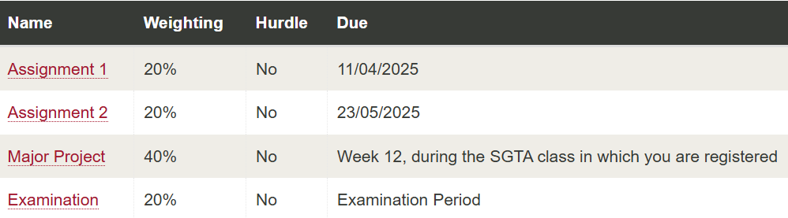
Assessment Components

Slide 12
Assessment
Assessments where Late Submissions will be accepted
Assignment 1 - YES, Standard Late Penalty applies
Assignment 2 - YES, Standard Late Penalty applies
Major Project - YES, Standard Late Penalty applies
Exam - NO, unless Special Consideration is Granted
Check iLearn for more details.

Slide 13
Final Assessment
The assessment of this unit consists of three assignments and a final exam.
You will submit the solutions to the three assignments via iLearn by the due date.
The final examination is a closed book examination, and will be taken in person during the exam period.
To pass this unit, you must achieve a total mark equal or greater than 50%.
This unit does not have hurdle assessments.

Slide 14
Plagiarism
You may discuss but not write together.
Read the Academic Integrity Policy. https://policies.mq.edu.au/document/view.php?id=3

Slide 15
Web Resources
The unit is available in iLearn (http://ilearn.mq.edu.au).
All the administrative material presented in this lecture is also available at this site.
Unit Outline.
Administrative Information.
Lecture Notes and recordings.
Pointers to Reading.
Other Useful Stuff.

Slide 16
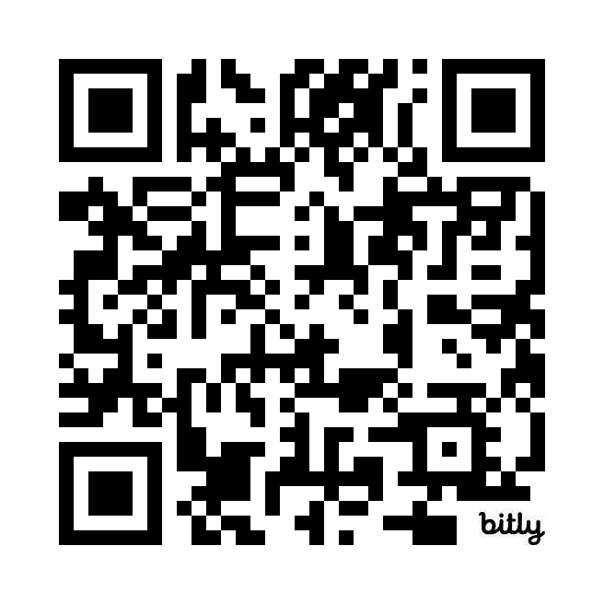
Are you considering using ChatGPT or other generative AI tools in this Unit? Check the unit information FIRST to help you follow the rules and consider the issues around use of gen AI in your study. Here’s an introduction to working with generative AI at university: https://bit.ly/3uxgQP4

Slide 17
Get to know each other
A short description of
Yourself
Learning background
Why this unit
Popular computer vision application

Slide 18
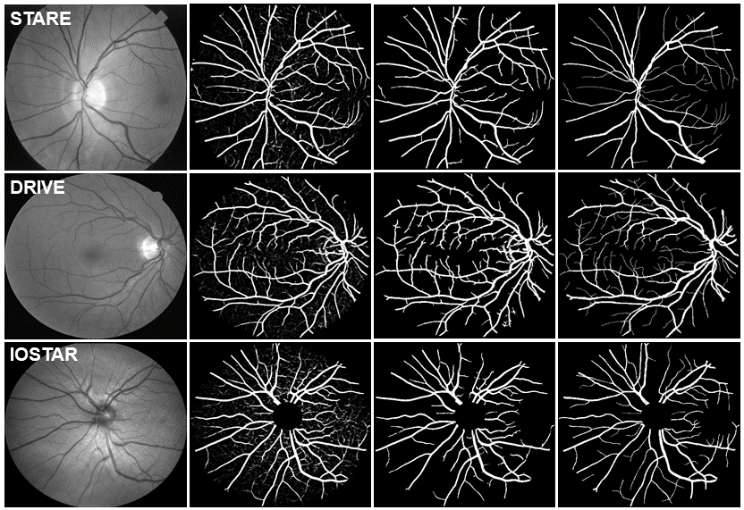
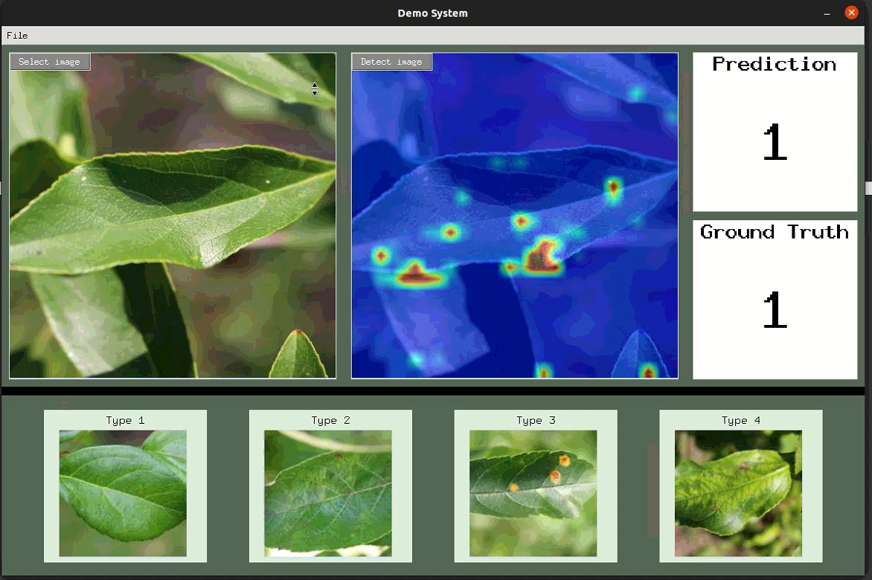
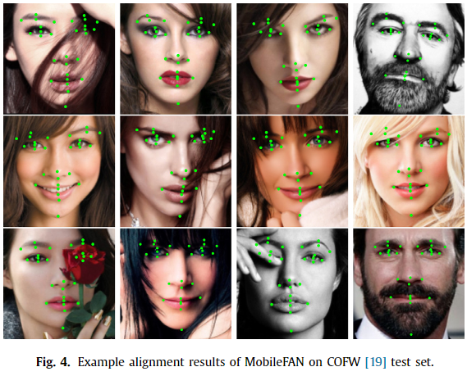
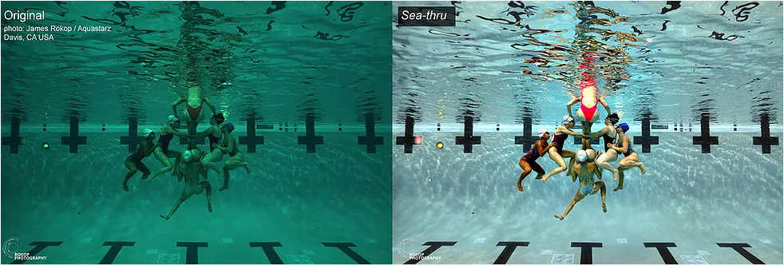
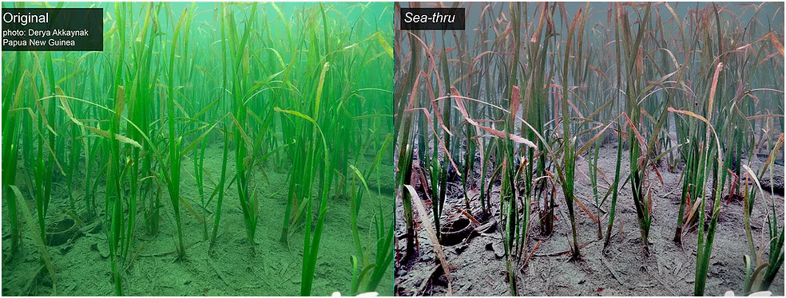
Applications
Agriculture
Health
Ecology
Economic
More
Retinal vein segmentation
Plant disease classification
Face landmark detection
Water removing

Slide 19

Lecture 1 Review of Basic Computer Vision
Dr Xiaohan Yu
Macquarie University

Slide 20
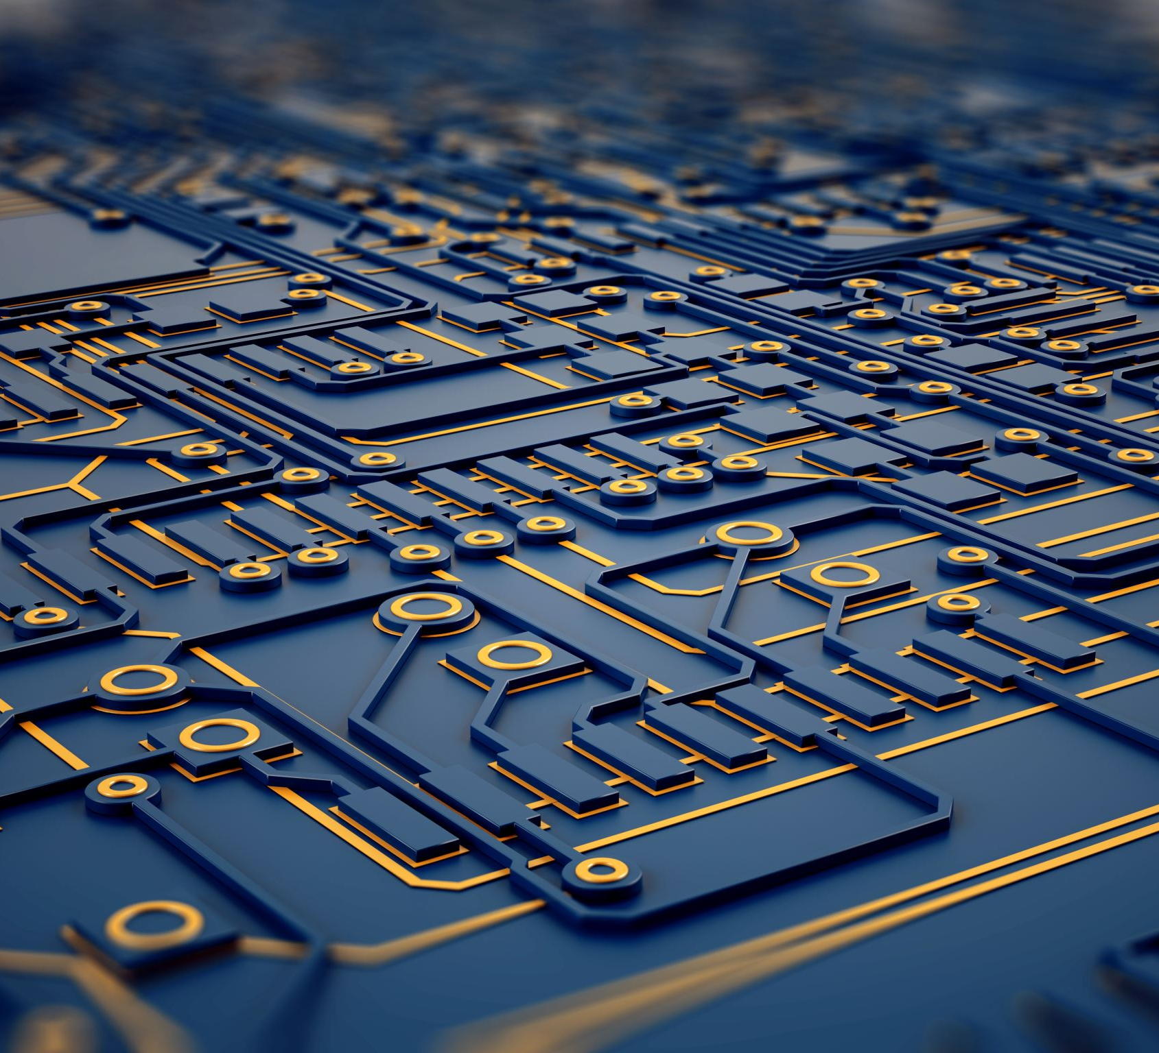
Fundamental Concepts in Computer Vision
Introduction to Computer Vision:
Image Representation and Processing
Feature Extraction
Image Classification
Object Detection and Localization

Slide 21

Fundamental Concepts in Computer Vision
Introduction to Computer Vision:
Computer vision involves the development of algorithms and techniques for interpreting and understanding visual data from the real world. It encompasses various tasks such as image classification, object detection, segmentation, and scene understanding.

Slide 22
Components
Applied AI
ML
DL
Machine Learning (ML)
--- Learn from data & predicts w/o being explicitly programmed
Deep Learning (DL)
--- Subfield of machine learning that utilizes artificial neural networks
Computer Vision (CV)
--- Perceive & understand visual information from images/videos
Natural Language Processing (NLP)
--- Understand, interpret, and generate human language
CV
NLP
Question: what can be achieved with the components?

Slide 23
Fundamental Concepts in Computer Vision
Image Representation and Processing:
Images are represented as arrays of pixel values. Basic operations include resizing, cropping, rotating, and filtering images using techniques like convolution and smoothing. Color spaces such as RGB, HSV, and grayscale are also fundamental concepts.
Is it necessary?

Slide 24

Fundamental Concepts in Computer Vision
Feature Extraction:
Feature extraction involves identifying informative characteristics from images that can be used for further analysis. Common techniques include edge detection, corner detection, and feature descriptors like SIFT, SURF, and ORB.
What is desirable feature?

Slide 25
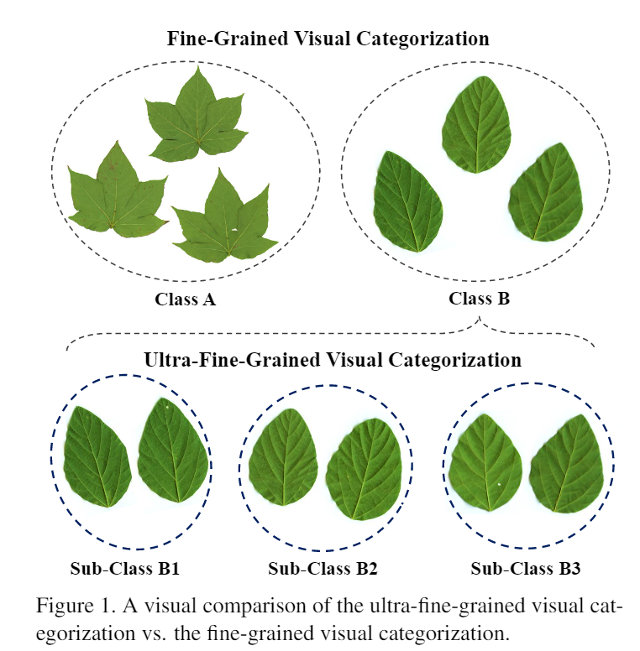
Fundamental Concepts in Computer Vision
Image Classification:
Image classification is the task of assigning labels or categories to images based on their visual content. Traditional approaches include machine learning algorithms like Support Vector Machines (SVM), k-Nearest Neighbors (k-NN), and decision trees. Deep learning methods, particularly Convolutional Neural Networks (CNNs), have revolutionized image classification in recent years.
Is it an easy task?

Slide 26

Fundamental Concepts in Computer Vision
Object Detection and Localization:
Object detection involves identifying and locating objects within images. Techniques such as sliding window-based methods, region-based convolutional neural networks (R-CNN), and single-shot detectors (SSD) are commonly used for this task.

Slide 27
Question
What to know in the very beginning for computer vision?

Slide 28
Image Enhancement
1. Introduction
1.1 What is image enhancement?
--- Modify the intensities of pixels in an image so that it can be more suitable for a specific application.
Different enhancement process suits different application.
An enhancement method is good for an application but maybe bad for another application.
Question: Is image enhancement related to advance CV?

Slide 29
Image Enhancement
1.2 Categories of methods for enhancement process.
Spatial domain: process pixels in the image plane directly.
Frequency domain: modify the Fourier transform of an image.
Yes! Low level vision – image denoising, super resolution. Key for CNN!

Slide 30
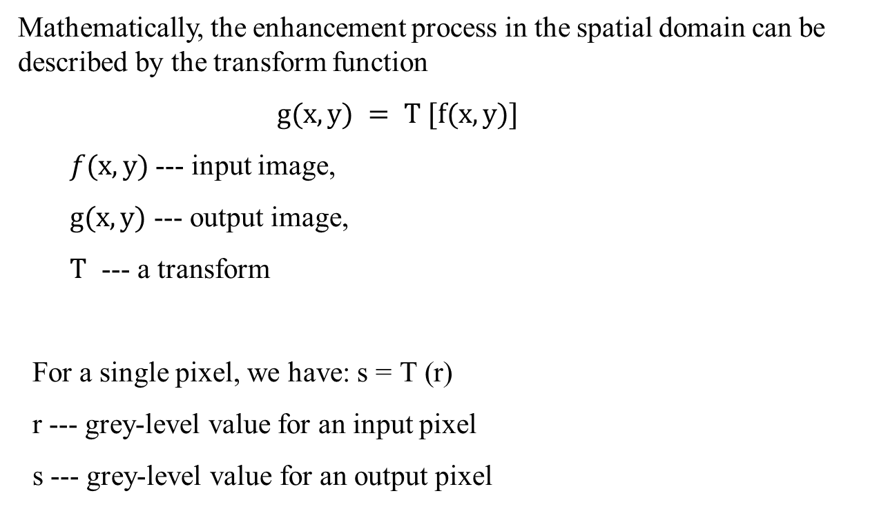
Image Enhancement
Mathematically, the enhancement process in the spatial domain can be described by the transform function
$g(x,y) = T [f(x,y)]$
$f(x,y)$--- input image,
$g(x,y)$ --- output image,
$T$ --- a transform
For a single pixel, we have: $\text{s}\text{ = }\text{T}\text{ (}\text{r}\text{)}$
r --- grey-level value for an input pixel
s --- grey-level value for an output pixel

Slide 31
Image Enhancement
Grey-level value transform graph
We use a graph to denote the transform function s = T (r) .
s
s
s
T(r)
T(r)
Dark - Light
T(r)=r
r
r
r
Dark - Light
No change image brighter image darker
Question: what will happen?

Slide 32
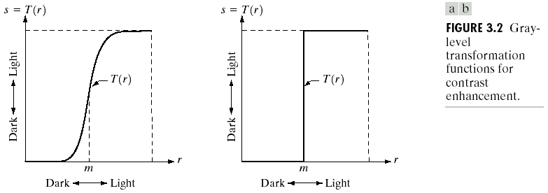
Image Enhancement
Two simple examples for contrast enhancement
x
Question: what will happen?

Slide 33
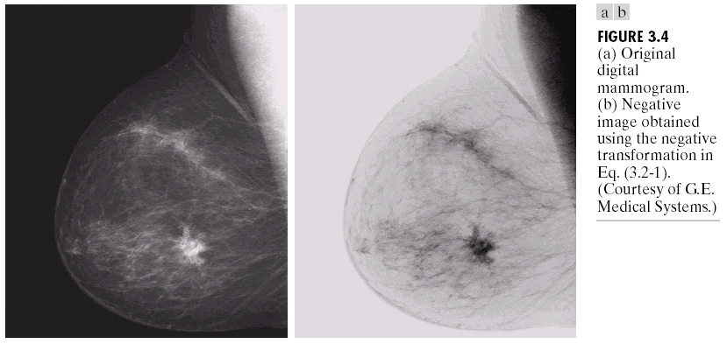
Image Enhancement
2. Transformations
2.1. Image negatives
L-1
T(r)
s
0
r
L-1

Slide 34
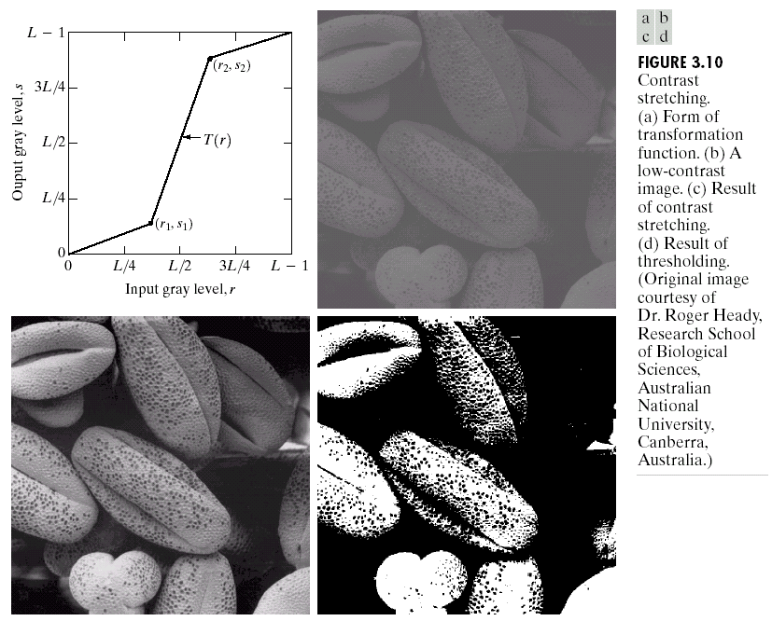
Image Enhancement
2.2. Contrast stretching
For a low-contrast image, we feel it uncomfortable and sometimes can not see details clearly.

Slide 35
Image Enhancement
Mathematically, We have following transform for stretching contrast.

Slide 36
Image Enhancement
3. Filtering
Removing or intensifying some components in an image by using
enhancement processing is called filtering.
Using spatial masks to process an image is called spatial filtering
Using the Fourier transform to process an image is called Frequency domain filtering.

Slide 37
Image Enhancement
3.1. Mask
Applying a mask to an image is a basic concept in image processing – convolution.
(1) What is a mask: A mask is a set of pixel positions with values called weights. A 3x3 mask is as follows.
1
1
1
1
2
1
1
1
1
2
4
2
1
1
1
1
2
1

Slide 38
Image Enhancement
(2) How to use a mask:
For any point (x,y) in the image, align the center of the mask to it. We have
(x,y)

Slide 39
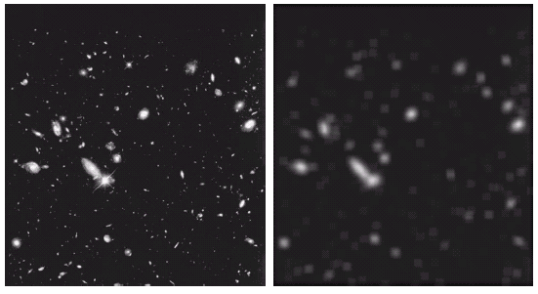
Image Enhancement
3.2. Smoothing filters
For low-pass filtering --- called smooth processing

Slide 40
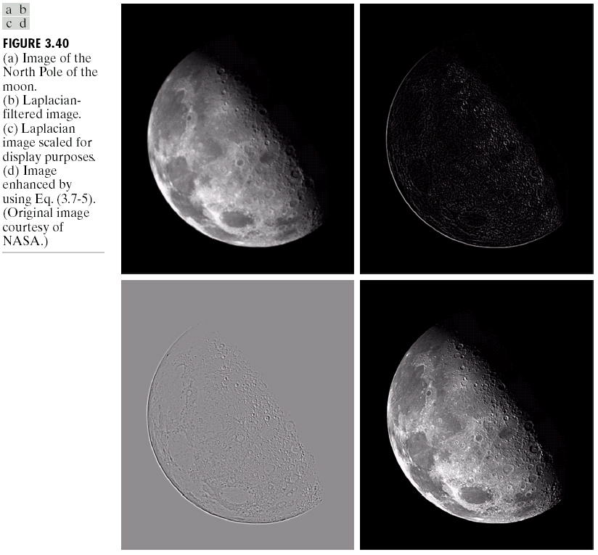
Image Enhancement
3.3. Sharpening filters
For High-pass filtering

Slide 41
Question
What else to know about start a computer vision project?

Slide 42
Basic Concepts
Data collection & processing
Training a model with the input data
Training loss
Error metrics

Slide 43
Tensor
Vector: 1D array
Matrix: 2D array
Tensor: an array with any number of dimensions
Rank: number of dimensions
Example: A matrix with 12 rows and 18 columns has a shape of (12, 18) and a rank of 2.
What is the size/dimension of an input image?

Slide 44
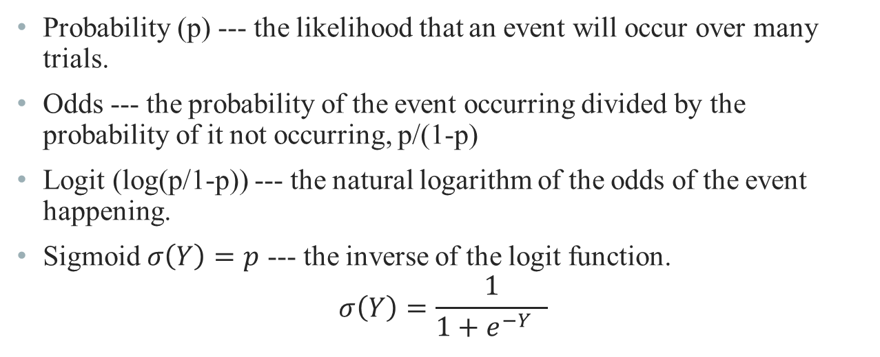
Output of classification model
Probability (p) --- the likelihood that an event will occur over many trials.
Odds --- the probability of the event occurring divided by the probability of it not occurring, p/(1-p)
Logit (log(p/1-p)) --- the natural logarithm of the odds of the event happening.
Sigmoid $σ\left(Y\right)=p$ --- the inverse of the logit function.
$$σ\left(Y\right)=\frac{1}{1+e^{−Y_{}}}$$
What is the sigmoid output range?
Try to derive from sigmoid to logit?

Slide 45
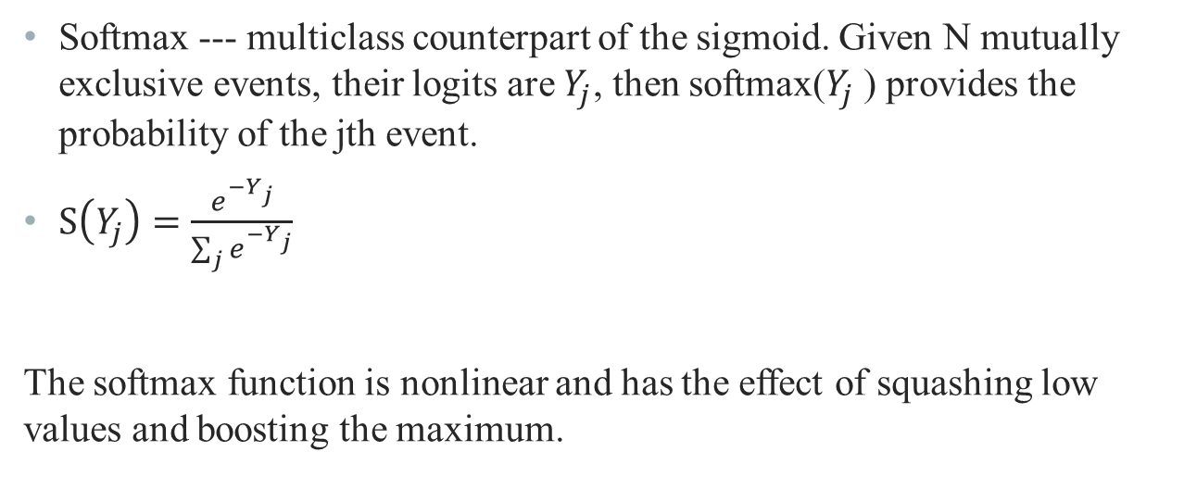
Output of classification model
Softmax --- multiclass counterpart of the sigmoid. Given N mutually exclusive events, their logits are $Y_{j}$, then softmax($Y_{j}$) provides the probability of the jth event.
$S\left(Y_{j}\right)=\frac{e^{−Y_{j}}}{\sum_{j}{e^{−Y_{j}}}}$
The softmax function is nonlinear and has the effect of squashing low values and boosting the maximum.

Slide 46
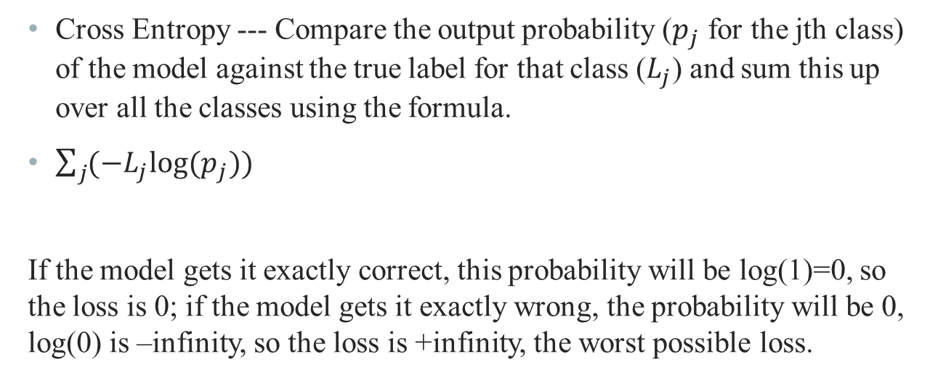
Training Loss for Classification
Cross Entropy --- Compare the output probability ($p_{j}$ for the jth class) of the model against the true label for that class ($L_{j}$) and sum this up over all the classes using the formula.
$\sum_{j}{{(−L_{j}log⁡(p_{j})) }^{}}$
If the model gets it exactly correct, this probability will be log(1)=0, so the loss is 0; if the model gets it exactly wrong, the probability will be 0, log(0) is –infinity, so the loss is +infinity, the worst possible loss.

Slide 47
Error metrics
Accuracy --- simply the fraction of instances that are classified correctly
Precision --- the fraction of true positives in the set of identified positives: TP/(TP+FP).
Recall --- the fraction of true positives among all the positives in the dataset: TP/(TP+FN).
F1 --- 2/[1/precision + 1/recall]
 | Predicted as Fake | Predicted as Genuine
Actual Fake ID | True Positives (TP) | False Negatives (FN)
Actual Genuine ID | False Positives (FP) | True Negatives (TN)

Slide 48
Tools
Pytorch (https://pytorch.org) & Tensorflow
--- Deep learning implementation framework
GitHub: https://github.com
--- Code access and management
Coursera: https://www.coursera.org
--- Lectures & theory for AI
Kaggle: https://www.kaggle.com
--- Competition in AI & Industry trend/need
Applied AI
ML
DL
CV
NLP

Slide 49
Conclusion
Role of CV
Revolutionize industries
Streamline operations
Open Discussion
Ethical concerns in CV
What is the future direction of CV?
Expected Outcome
Understand key concepts in CV
Learn practical tools to implement CV
Address complex challenges
Build your own applied CV project
Can CV be superior to Humans?

